Slide 1
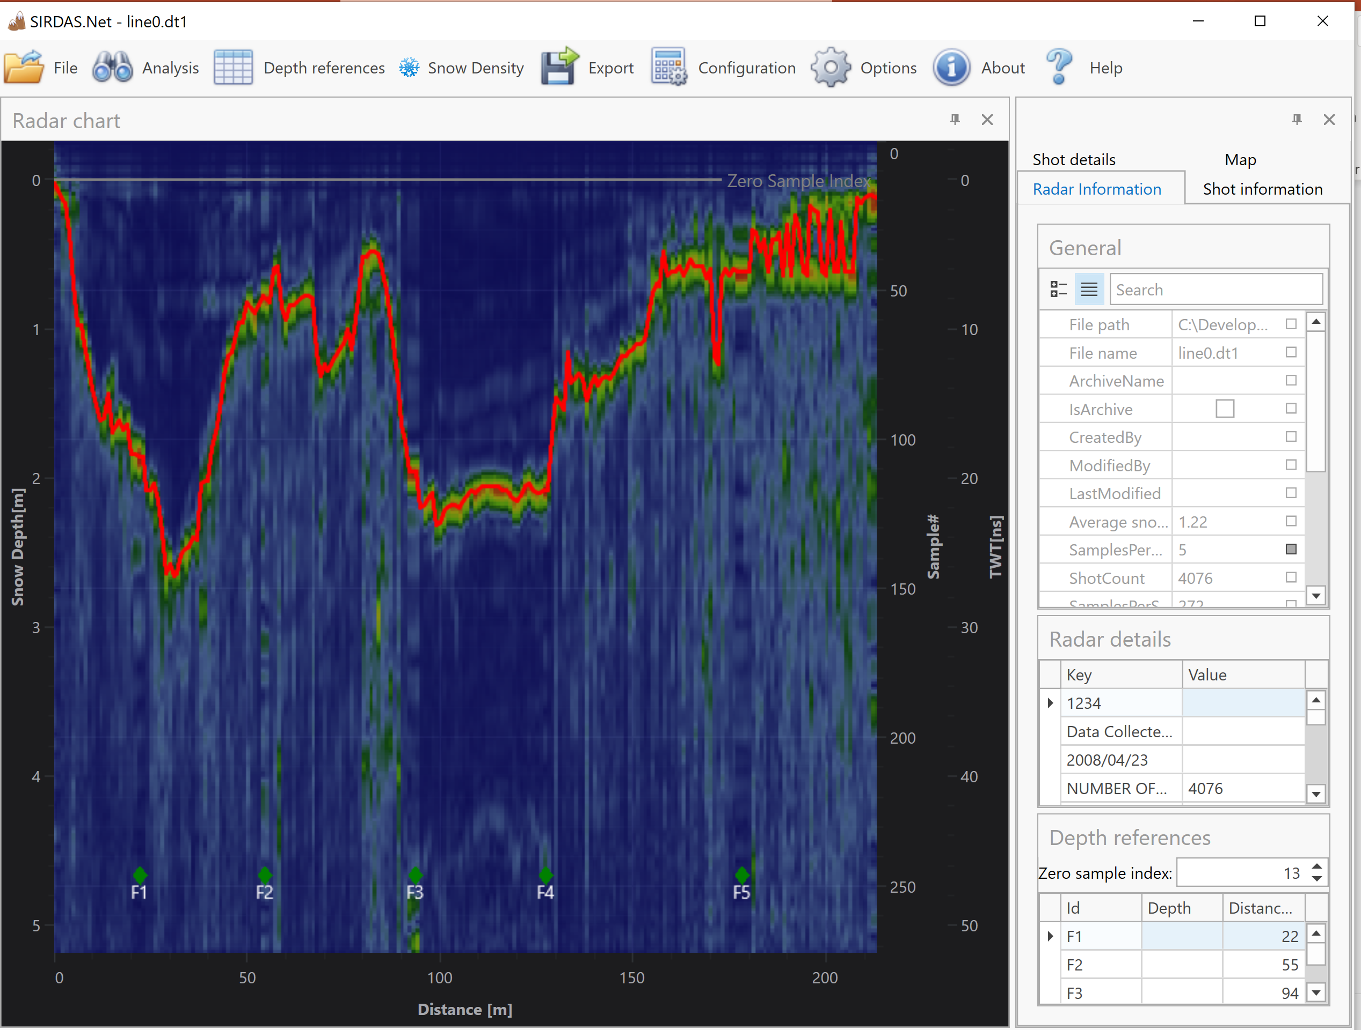
SIRDAS.Net
Introduction to SIRDAS.Net v3.11
February, 2024
http://www.albrektsen.net/sirdas
Espen Halsaa Albrektsen espen@albrektsen.net

Slide 2
Agenda
Changes since v3.11
Getting started
Installation
What is SIRDAS.Net
Basic operation
Opening a file
Depth Reference measurements
Snow Density measurements
Data export
Advanced operation
Manual route correction
Data analysis tuning
Vertical filters
Horizontal filters
Route finder

Slide 3
Changes since v3.10
v3.11
Exclude shots complete rewrite
Possible to add position to marker if dataset is missing GPS
Fixed “bug” in EvenSpacedDistanceFilter – “DistanceFromStart” is now always increasing

Slide 4
Getting started
Download and install SIRDAS.Net from
http://www.albrektsen.net/SIRDAS
You need some Microsoft tools – these are downloaded automatically if not allready installed on your system
Start the application, and request a license key
A request is posted to my web site – I manually generate a license key and email back to you. (Expect 1-3 bussiness days delay)
Start the application, and register the license key
Start the application – you are good to go! ☺

Slide 5
Supported radar formats
NogginPlus (.dt1)
Malå (.rd3)
ImpulsRadar (.iprb)
For all data formats, there exists more than one file. SIRDAS assumes that files that belong together have the same filename. Typically
A file with «markers»
GPS data
«metadata» - like radar serial number and settings

Slide 6
Basic Operation
NogginPlus file format
Each scan consists of 3 files, with file types ‘.dt1’, ‘.hd’ and ‘.gps’. These three files must be in the same directory and have the same filename:
When a .dt1 file is selected for analysis, SIRDAS.Net immediately starts processing the file data.
If the NogginPlus file contains reference points (Fiducial Markers in the NogginPlus manual). SIRDAS.Net assumes that a NogginPlus Fiducial Marker is a manual depth measurement, and allows the user to enter this information.

Slide 7
Plot navigation
Mouse wheel is supported
Rolling the wheel zooms in and out
Wheel pans left and right (After you have zoomed)
Zoom out
Press ESC key
By using the mouse wheel
By double clicking right mouse button
Zoom in
By selecting a range
Pan
By mouse or keyboard.
Ctrl-arrow moves to start or end

Slide 8
Depth References
Used to calibrate wave propagation velocity, and to to adjust for equipment-specific depth offset

Slide 9
Purpose
Used to calibrate the conversion between sample index and depth.
Average wave velocity defaults to 0.2m/ns
The radar signal is sampled at a fixed interval (samplerate) – a sampleindex is therefore a representation of the two-way travel time from radar to ground and back
The wave velocity varies with snow density and needs to be calibrated
Zero-level
Zero-level is initialized to the value calculated by the Cut-off-filter. (See filter section for details)
The zero-level offset depends on equipment and also needs to be calibrated.
Zero-level can be updated manually, or reference points for zero level can be entered.

Slide 10
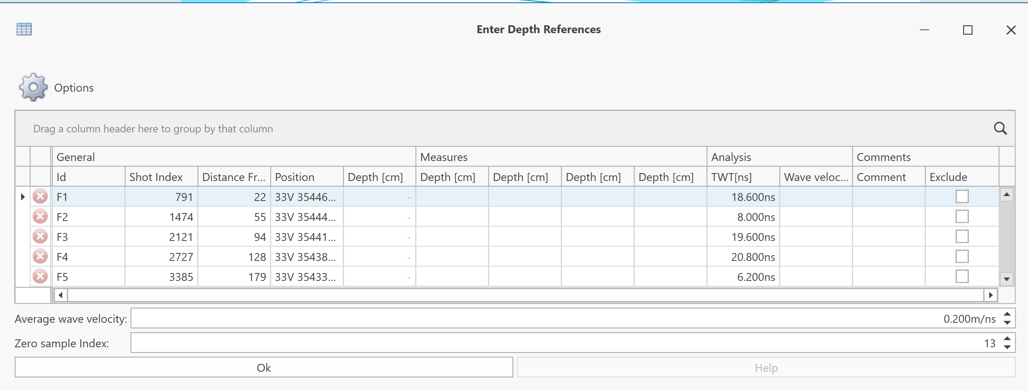
Depth Reference Form
ShotIndex is the position of this Depth reference
WaveVelocity for this shot
Average wave velocity
Depth is manually entered by the user
Two Way Travel Time for this entry

Slide 11
Depth reference form
SIRDAS supports entering multiple depth measurements for each reference. The average value will be used:
The number of measures to enter can be configured:

Slide 12
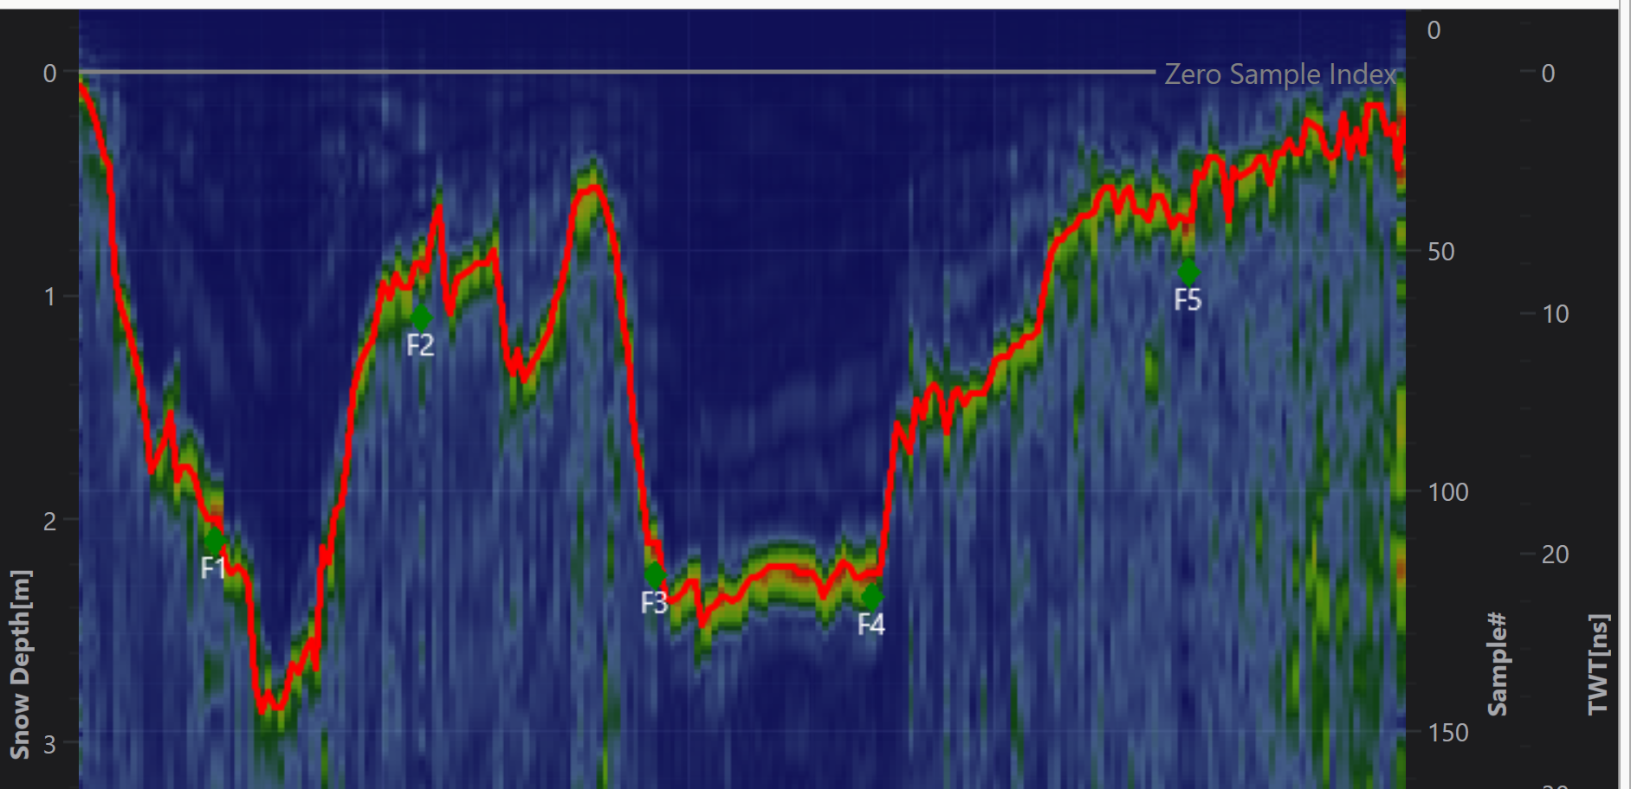
Depth Reference Form
Reference point is plotted at «correct» depth and position
Zero-level offset clearly visible in graph

Slide 13
Zero-level index
Manual override either
By entering a depth reference of zero meters
Or by adjusting zero sample index directly

Slide 14
Snow Density Observations
Used to calibrate the formula for converting snow depth to snow-water equivalent (SWE)
$$Density\left(depth\right)={Density}_{ref}+b\left(depth−{depth}_{ref}\right)$$

Slide 15
Snow Density Measurements
Is used to calculate the snow-water –equivalent (SWE)
Since snow density is a function of several factors, many observations can be used to increase density prediction accuracy
The density equation is
$$Density\left(depth\right)={Density}_{ref}+b\left(depth−{depth}_{ref}\right)$$
where b is the Global Snow Density gradient

Slide 16
Local vs Global Snow Density
Local Density
Global Density
Used to calculate the average density for this scan
Can be automatically selected if position data is registered in the snow density form
Used to calculate the global density gradient
Linear regression is performed to calculate b
Outliers can be automatically discarded

Slide 17
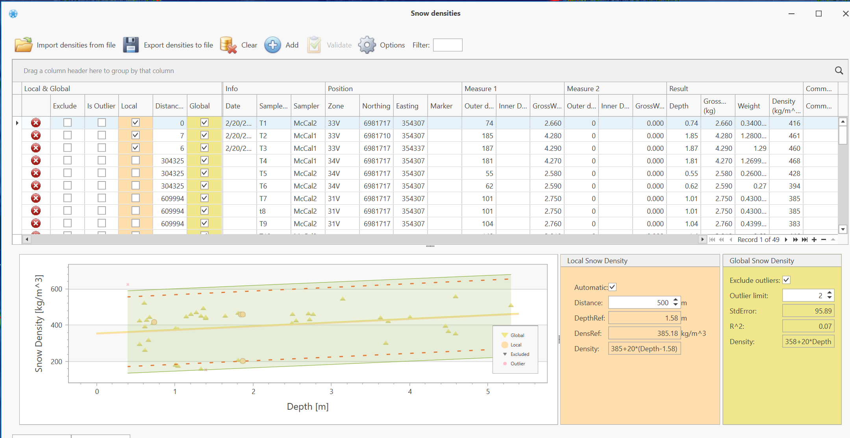
Snow Densities
Gross weight measured
Measured density
Automatic outlier removal
Depth measured
UTM position of this observation
StdError of selected measures
Exclude this observation by removing check mark
R² of selected measures
Visualization
Equipment used to take measure
Global Density equation

Slide 18
SnowDensityForScanForm
Automatic selection (Requires position data)
Selected for local snow density
Distance from this observation to this scan
Resulting local snow density
Local snow density equation
Global snow density gradient, b

Slide 19
Data Export
Saving data…

Slide 20
Export Reports
Route data
Detailed report (mostly for internal validation)
Snow Water Equivalent
This is the «core» export from SIRDAS
Radar data
Detailed report (mostly for internal validation)

Slide 21
Snow Water Equivalent Report

Slide 22
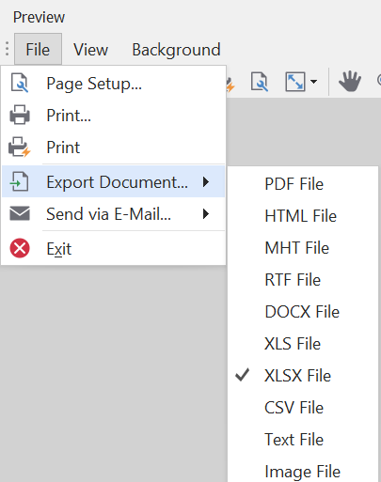
Export formats

Slide 23
Report contents
Header

Slide 24
Report contents
Report footer contains
Depth References
Snow Densities
Density samplers
Filter configuration

Slide 25
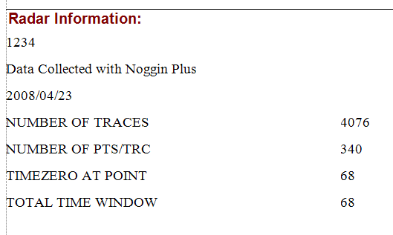
Report contents - ctd
Report footer contains
Radar information (From the radar header file)
Snow Density Equation
Filter configuration

Slide 26
Saving data
The analysis can also be saved to a .SIRDAS file
Contains all raw data used to generate the route
Contains the image generated by the raw data (as a picture)
.SIRDAS files can be used
To quickly review historic data
To update SWE report data by modifying Depth Reference information or Snow Density Measures
In order to save disk space, SIRDAS files must be reprocessed before changing routes

Slide 27
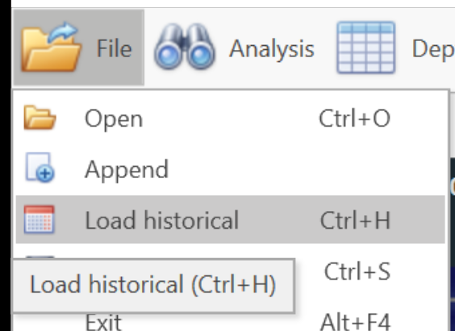
Historical data
SIRDAS also supports loading historical data onto the current chart
You can then select which files to import
May need file upgrade because previous versions lacked information needed for the historical import
You select a «root» folder, and SIRDAS will autoselect files that are «close» - GPS position data required

Slide 28
Historical data
Files that are «close» are auto selected
Files saved in previous versions need upgrade

Slide 29
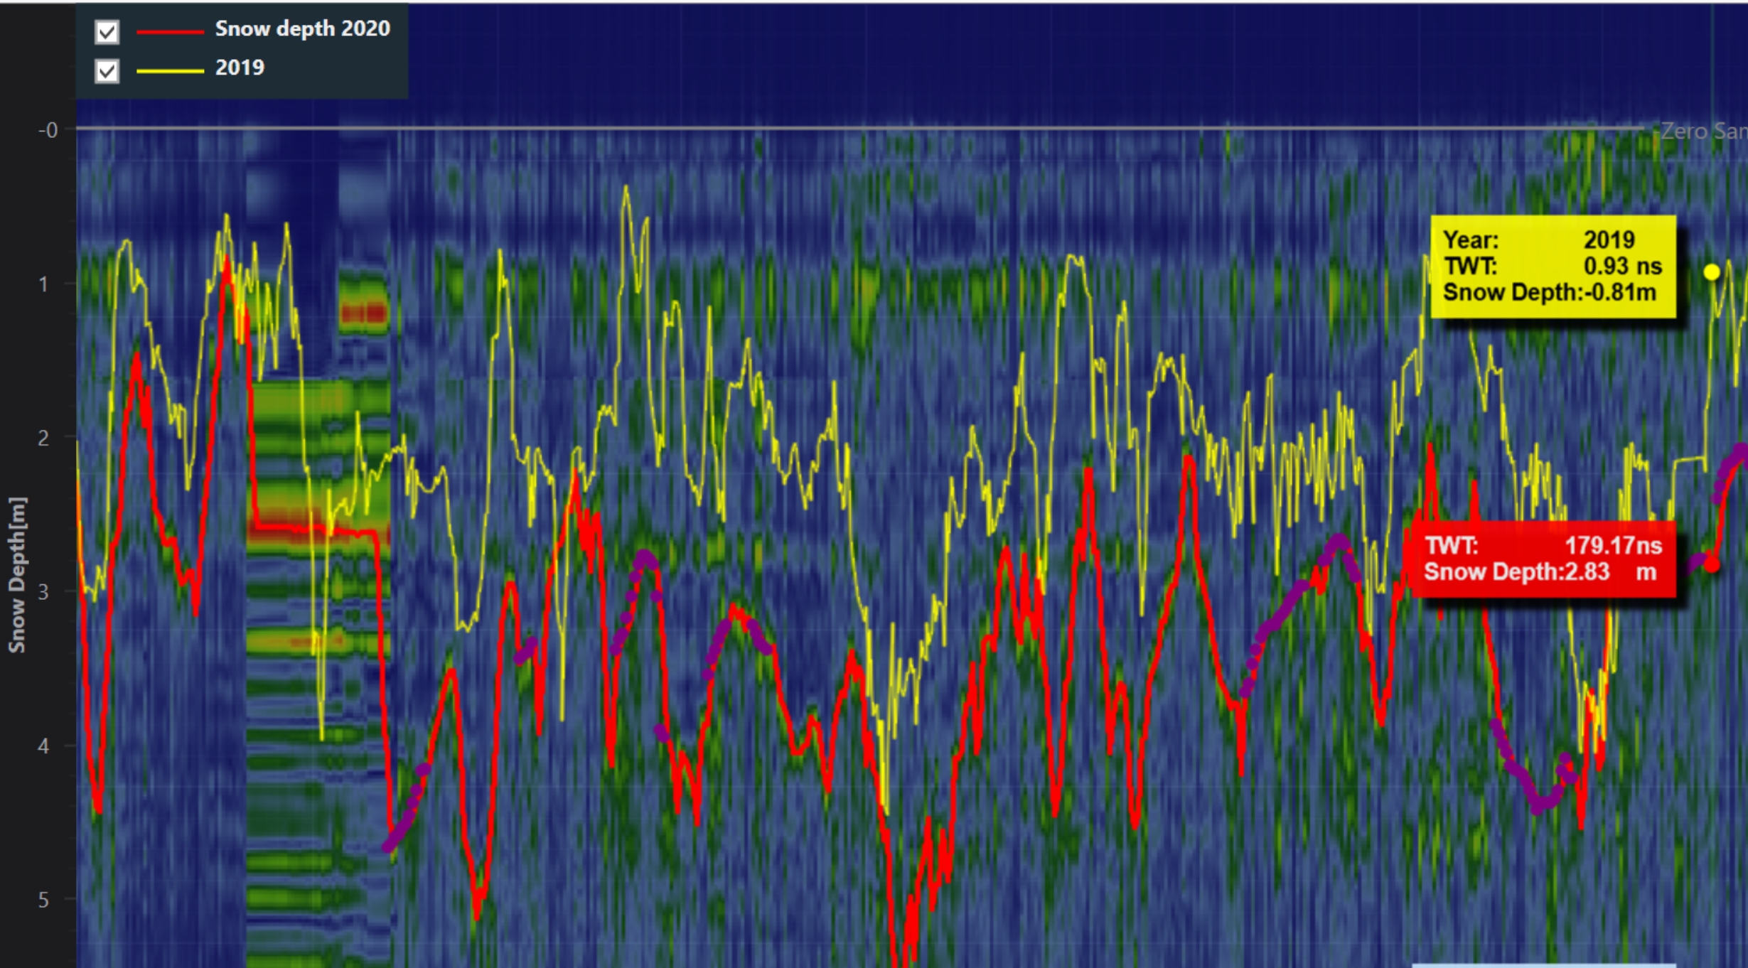
Historical data
After the files are selected, they will show up as an overlay on the current year’s data.

Slide 30
Advanced features
Manual route correction
Analysis configuration
Manual grouping
Excluding shots

Slide 31
Manual Route override
Sometimes the SIRDAS analysis is unable to make a correct path through the data points.
You can then use the mouse the correct the data by drawing new datapoints
Ctrl-mouse Adds «manual» points
Ctrl-shift-mouse Removes route correction
Recalculate route to check effect

Slide 32
Manual route correction
After correction:
After recalculation:

Slide 33
SIRDAS Configuration
Filters, PeakDetectors and RouteFinders

Slide 34
Overview
Vertical filters
Focus on one radar shot
Needed to suppress ringing and compensate for the attenuation of the radar signal through the snow
Perform a «chain» of filters
Horizontal filters
Uses GPS data to group shots that are geographically close
SIRDAS-v3.9 also adds a «Manual Grouping Filter» that is useful if GPS data is missing/corrupt
Route finder
the «core» of SIRDAS – finds the snow-ground reflection
Peak detector – more or less obsolete
Registration – license and your email in case of SIRDAS crash
GPS Config – GPS Options

Slide 35
Filter configuration
Vertical filters
NeighboringAverageRingingFilter
DepthFilter – Compensates for signal attenuation in snow
LowPassAndMagnitudeFilter – Removes high-frequency oscillations, and converts sample value to amplitude
Old and experimental filters
CutOffFilter – Removes large signal at start of data
FftRingingFilter
GainBasedRingingFilterRingingFilter

Slide 36
Why change filter config
It is very hard to accurately analyze the data at the «start» of the shot
The outgoing signal amplitude is very large – sometimes even saturates the signal
For small snow depths, the reflection signal is much weaker than the outgoing signal.
I call this effect «ringing» - and I have spent a lot of time trying to remove this artifact from the data
The best solution so far is to leverage the fact that the ringing is «constant» for a given file.
Sometimes it is not – for example if something happens to the radar
The «ringing» is not expected to be constant when snow depth is small

Slide 37
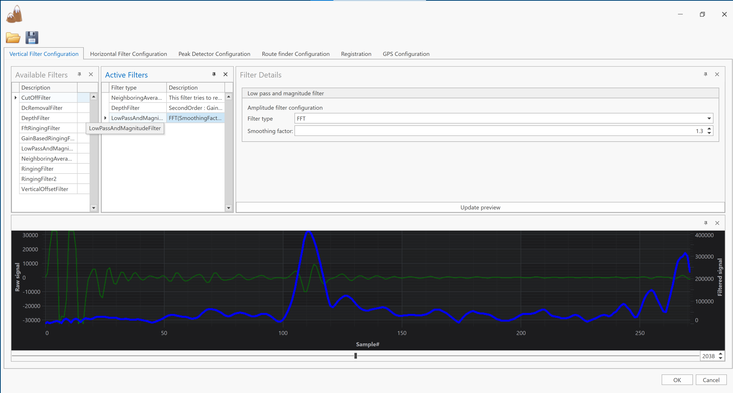
Vertical filters
Which shot to preview
Modify filter parameters
User interface for changing configuration
Shows preview of original data and filtered data
Available filters
Active filters (Drag and drop to change)
Preview filter effect
Unfiltered
Filtered

Slide 38
LowPassAndMagnitudeFilter
SmoothingFactor=0:
SmoothingFactor=1.3

Slide 39
Neighboring Average Ringing filter
Cutoff sample
All samples before cutoff are set to zero
Reducing this number will increase processing time
Setting it too large will lead to overestimating the snow depth
Last ringing sample
This filter only applies to the start of the samples
Increasing this will increase the processing time because more data must be processed
Neighbor mode
Distance – when GPS available
Shot index – when GPS missing
Max & Min distance:
Shots that are within this selection for each shot is used to calculate the ringing

Slide 40
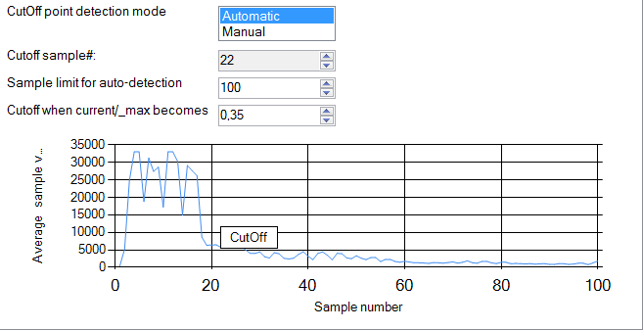
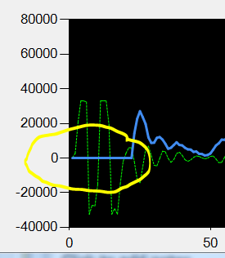
CutOffFilter
Removes the large signal from the snow surface
Averages first n samples in all shots
Looks for first sample where average is below treshold:

Slide 41
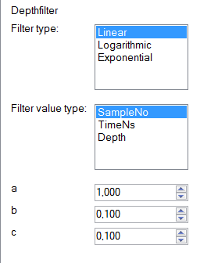
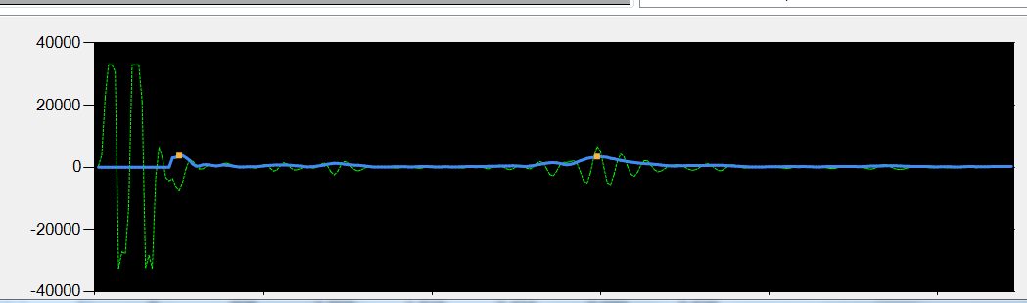
Depth filter
Compensates for the signal attenuation in snow:
b=0:
b=0.1:

Slide 42
Horizontal filters
Combines shots that are «close» – requires GPS information to be present in radar data.

Slide 43
Peak detector
Detects peaks in the filtered data – not really used anymore. (Version 3.0 used peaks, 3.1 has an improved route finder algorithm).

Slide 44
Route finders
This is the core algorithm in SIRDAS.Net
Version 3.1 introduced the «Advanced Cheapest Cost Route Finder»
Uses DIJKSTRA algorithm to calculate the «cheapest» path through the radar data.
Relies on a tunable cost function – this function makes it «expensive» for the route to make large jumps, and makes it «cheap» og through strong data points
The parameters can be tuned – see tooltip for explanation.
The other route finders are less accurate, but are faster. They should be avoided, and are kept in the product primarily for historic reasons.

Slide 45
Missing GPS data
- Sometimes, the GPS fails to deliver data
- How to recover the data anyway

Slide 46
How to analyze data without GPS
Two options as of v3.11
Manual grouping and update the TotalDistance property
Add markers and set GPS position

Slide 47
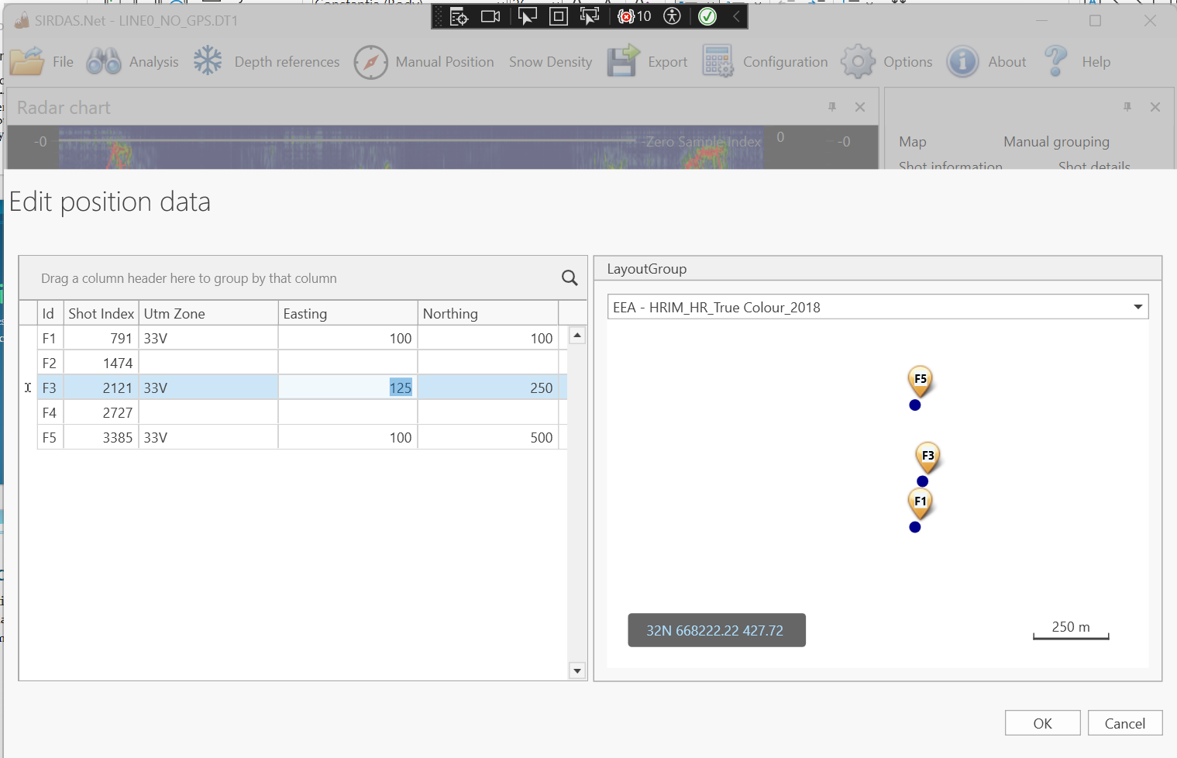
Manual Positions
If GPS data is missing – there is new menu
Pressing this menu will allow you to add positions for all markers

Slide 48
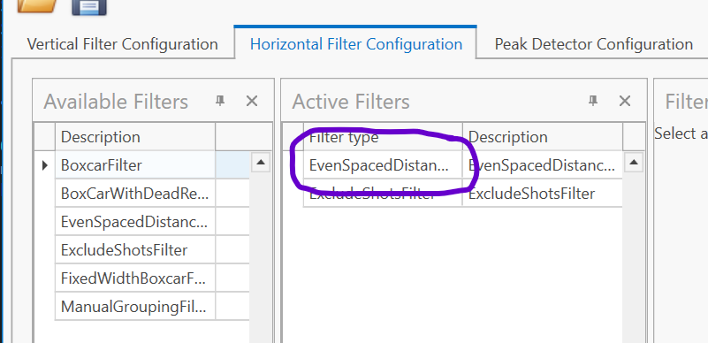
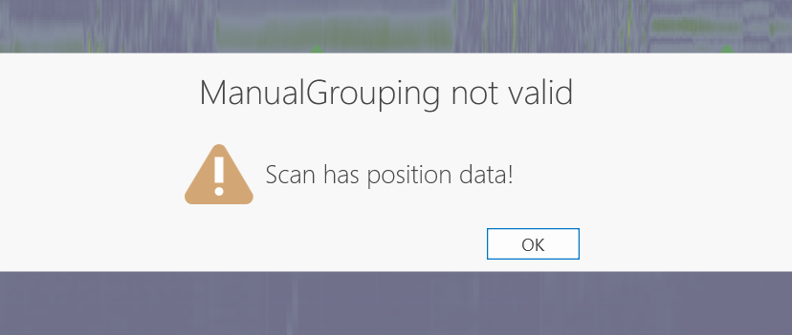
Config change after adding pos
After adding manual positions, the filter may need to be updated
A GPS based horizontal filter should be added:
NB: There is a bug in 3.11.2 – after adding manual positions, manual groups are added. This will be fixed.

Slide 49
Manual grouping
- This filter is designed to handle the scenario where the GPS data is missing

Slide 50
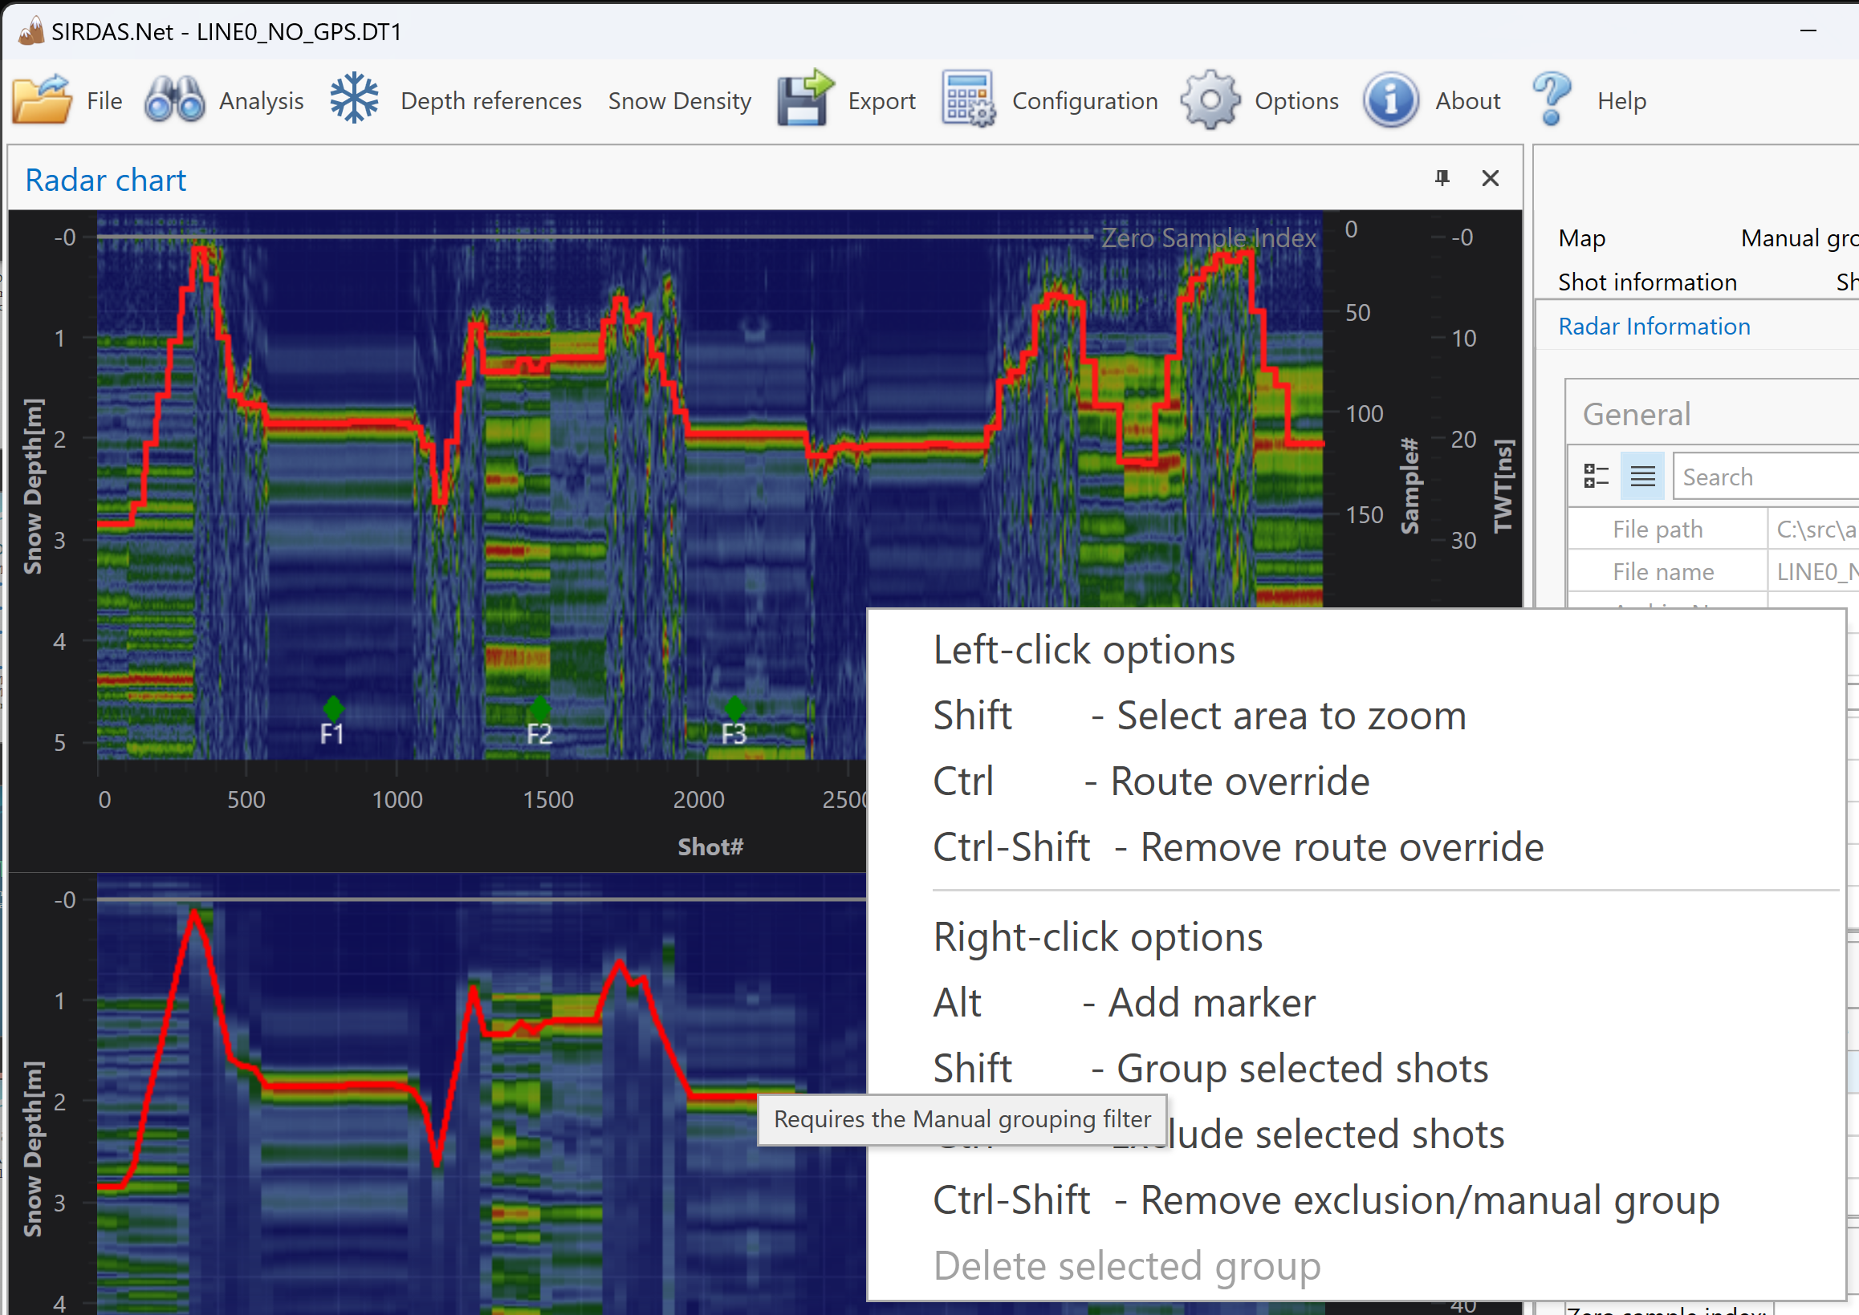
Manual Grouping filter
After loading a file where GPS data is missing, right-click in order to get to the context menu:

Slide 51
Validate the total distance

Slide 52
Total distance can be changed

Slide 53
Group all shots that were taken while not moving

Slide 54
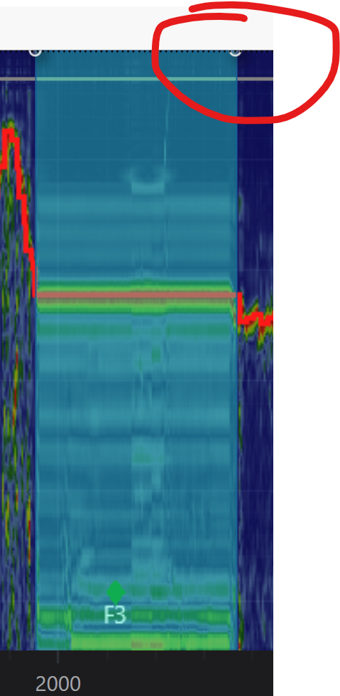
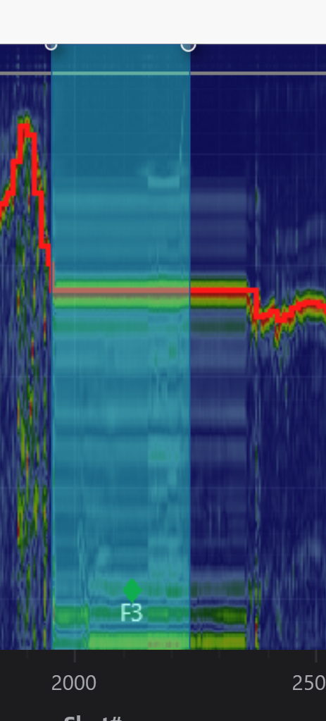
Editing manual groups
It is possible to modify manual groups
Click a group, then drag the “corners” of the group marker:

Slide 55
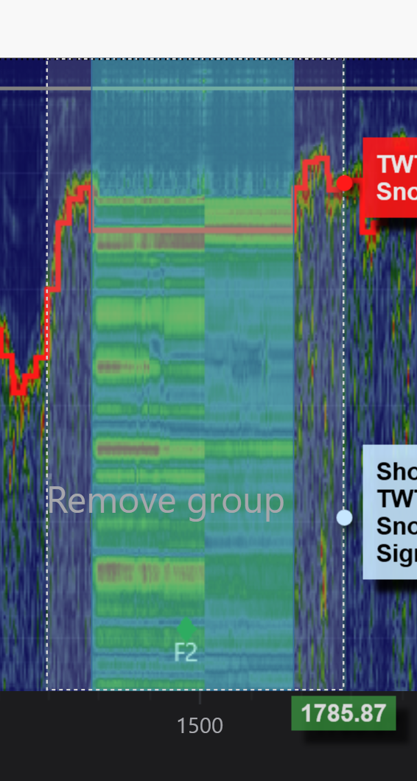
Delete a manual group
Use ctrl-shift+right click in order to delete a manual group:

Slide 56
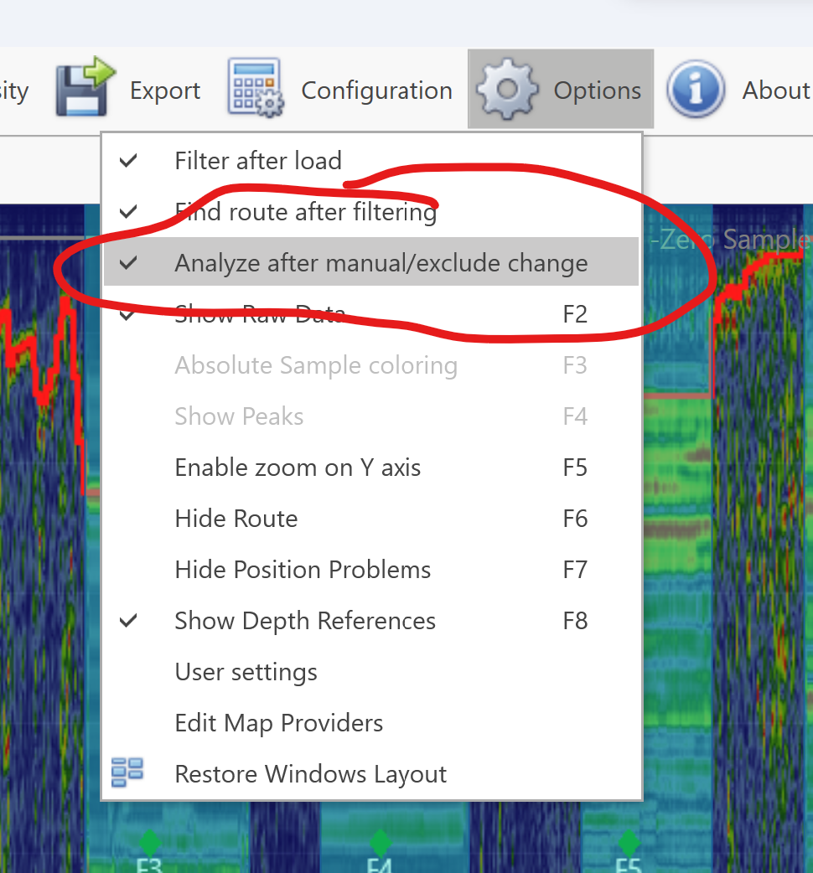
Analysis must be re-executed
You need to re-execute analysis after changing manual groups
By default, this is done automatically
However – if your file is very large, you may want to disable auto-analyze

Slide 57
Exclude shots
It has been “possible” to exclude shots in SIRDAS.
However – this has been buggy and the most frequent cause for fatal crashes.
In SIRDAS v3.11, the Exclude Shots feature was completely rewritten
As a consequence, “old” files using excludes will need update on load
The new exclude feature is more focused

Slide 58
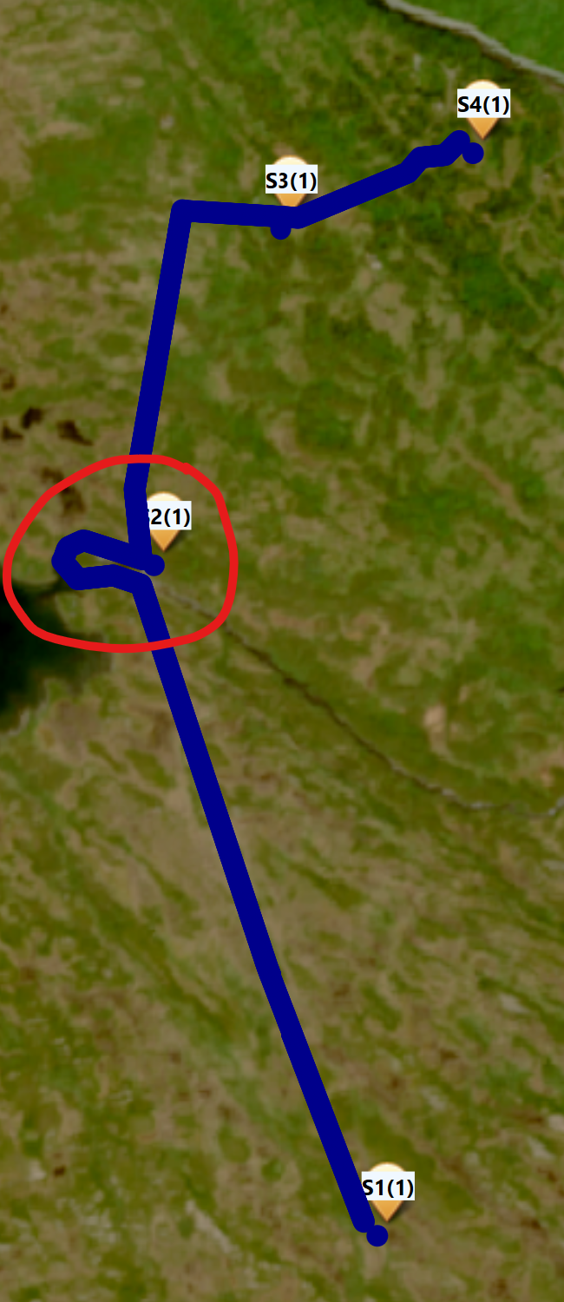
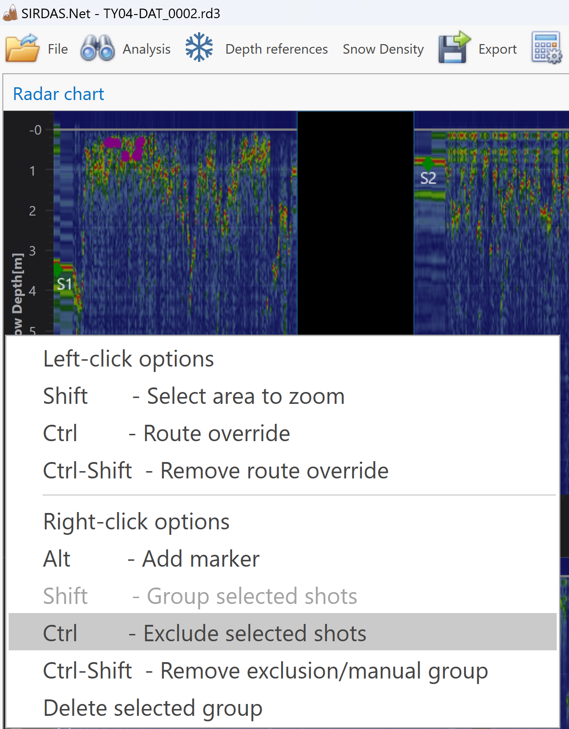
Exclude shots use cases
The primary use case for excluding shots is the scenario where some obstacle forces you to take a detour that you want to exclude from the scan
This can now be done by right-clicking in the distance data while pressing ctrl key

Slide 59
Exclude shot filter is auto-added

Slide 60
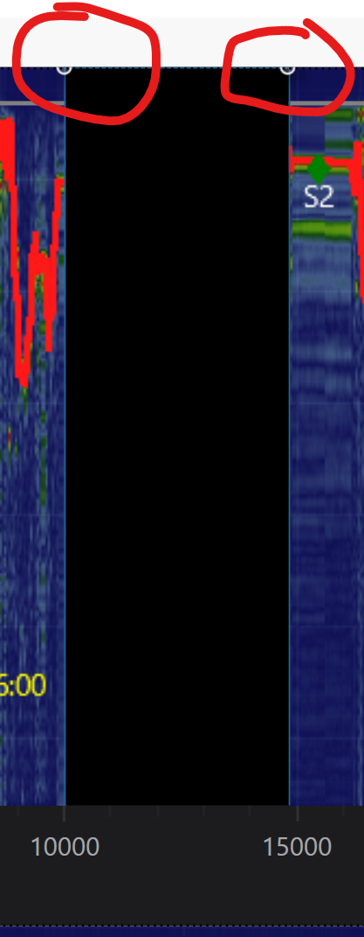
Exclude section can be modified
Click the exclude group and drag the corners
Perform adjustments in the “Shot#” chart
Exclude groups can be dragged and deleted the same way manual groups can

Slide 61
Options
Display options

Slide 62
Options
Zoom Y-axis: Check this in order to zoom on the Y axis
Show Raw Data: Show the data without the horizontal positionfilter applied
Absolute sample coloring: When selected, the color showing the echo strength is scaled globally – default value is that each shot is scaled to maximize visibility. The relative sample coloring makes weak signals look strong – use absolute coloring when you suspect this…

Slide 63
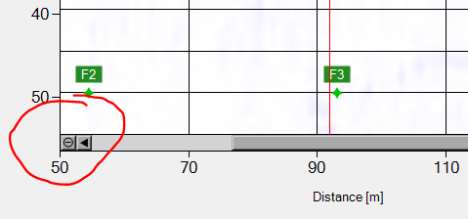
Plot navigation
Mouse wheel is supported
Ctrl+wheel zooms in and out
Wheel pans left and right (After you have zoomed)
Zoom out
By using the mouse wheel
By pressing the zoom out button:
Zoom in
By selecting a range
Pan
By mouse or keyboard.
Ctrl-arrow moves to start or end

